Slide 1
Machine Learning Models for Breast Cancer Survival Prediction using Gene Expression Profiles
Presented by: Raghad Alharbi
MiSK Academy & General Assembly
Data Science Immersive Course
Capstone Project

Slide 2
Table of Contents
01
02
03
Introduction
Data Description
EDA & Visualization
04
05
Preprocessing & Modeling
Conclusion

Slide 3
Introduction
Breast cancer is the most frequent cancer among women
It impacts 2.1 million women / year.
About one in 4 of all new cancer cases diagnosed in women worldwide are breast cancer.
In 2018 alone, 627,000 women died from breast cancer (15% of all cancer deaths among women)
Accurate estimation of prognosis and survival duration is the most important part of a process of clinical decision-making in patients with malignant disease.
(WHO) (Van't Veer et al.,2002)

Slide 4
Why should we use genetic data in cancer research?
Cancers are associated with genetic abnormalities
Gene expression measures the level of gene activity in a tissue and gives information about its complex activities.
Comparing the genes expressed in normal and diseased tissue can bring better insights about the cancer prognosis and outcomes.
Using machine learning techniques on genetic data has the potentials of giving the correct estimation of survival time and can prevent unnecessary surgical and treatment procedures.

Slide 5

Data Description
The METABRIC is a project that contains targeted genetic sequencing data of 1,980 primary breast cancer samples.
Clinical and genomic data was downloaded from cBioPortal website, which is an open-access, open-source resource for cancer genomics data sets.
(Pereira, B, et al, 2016)

Slide 6
Data Description
METABRIC database (1,980 sample size)
Clinical Data
( 31 features)
mRNA levels (331 features)
Genetic Data
Mutations (175 features)

Slide 7
Clinical Features
Numerical Feature | Mean | Standard Deviation
Age | 61.08 | 12.97
Lymph nodes examined positive | 2.00 | 4.07
Mutation count | 5.69 | 4.05
Tumor size | 26.23 | 15.16
Categorical feature | Unique values | Most frequent | Probability
Tumor stage | 5 | 2 | 0.40
Chemotherapy | 2 | False | 0.76
Hormonal therapy | 2 | True | 0.59
Radio therapy | 2 | True | 0.57
Type of breast surgery | 2 | Mastectomy | 0.56
Pam50 + claudin-low subtype | 7 | LumA | 0.34

Slide 8
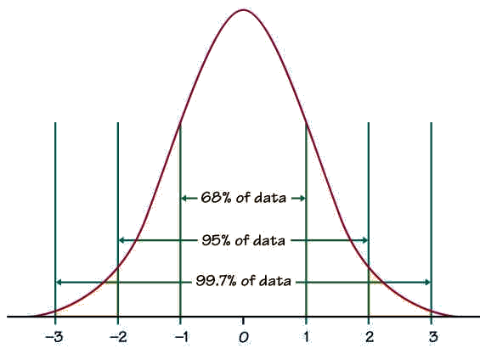
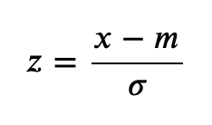
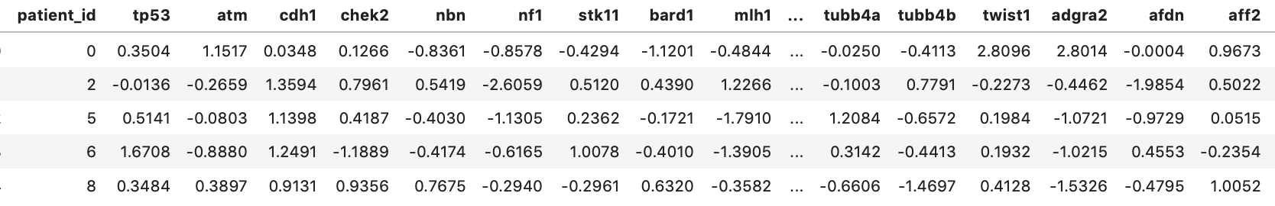
Genetic Features
mRNA z-scores for each gene:

Slide 9


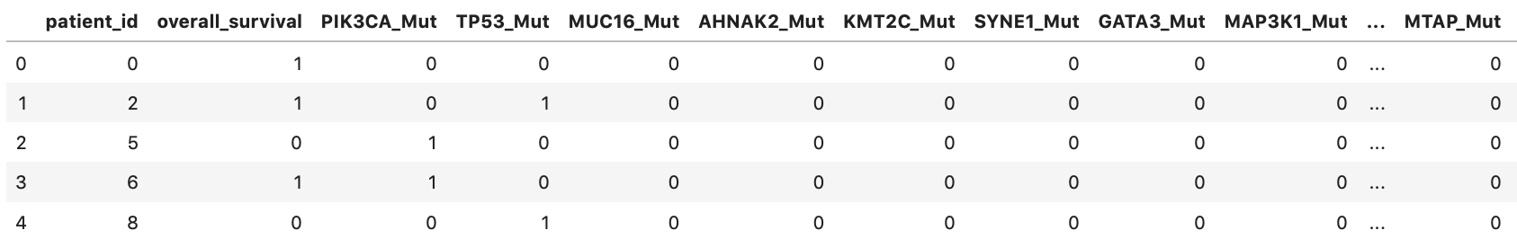
Genetic Features
Mutations in each gene:
Mutation in 40% of the sample
Mutation in 16.2% of the sample

Slide 10

EDA & Visualization

Slide 11
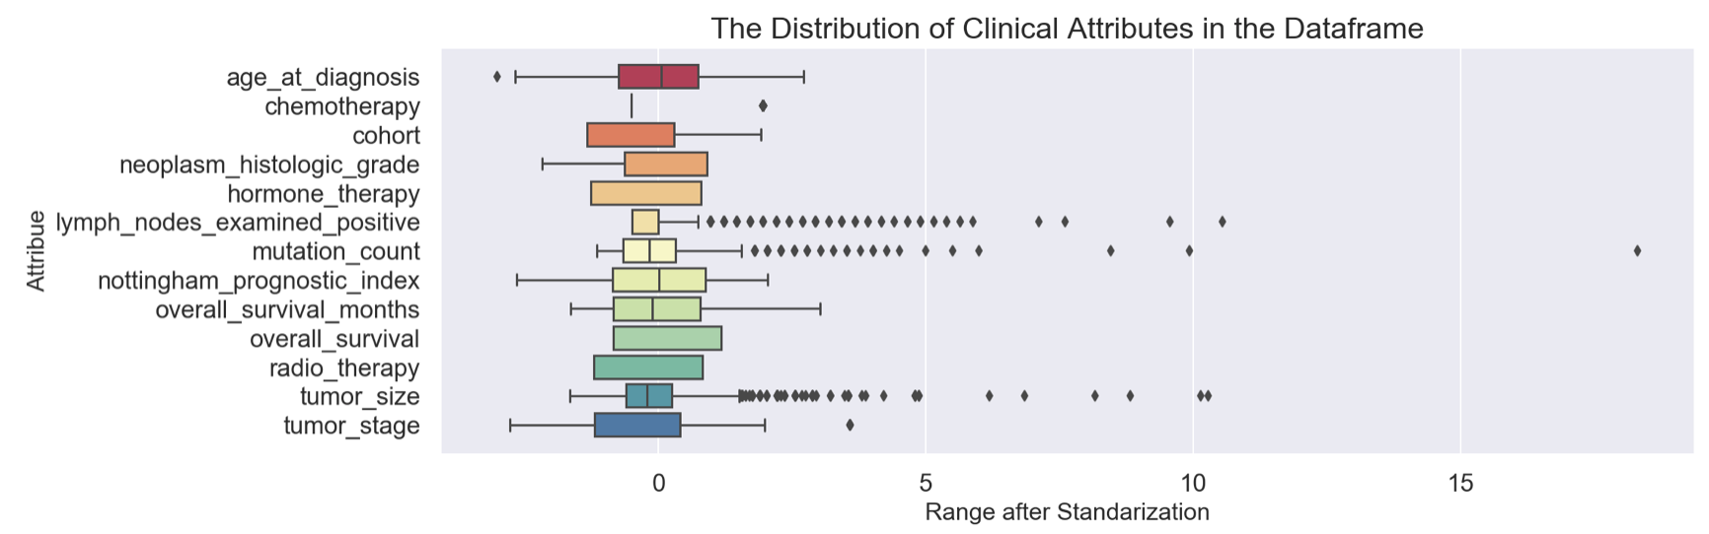
The Distribution of Clinical features

Slide 12
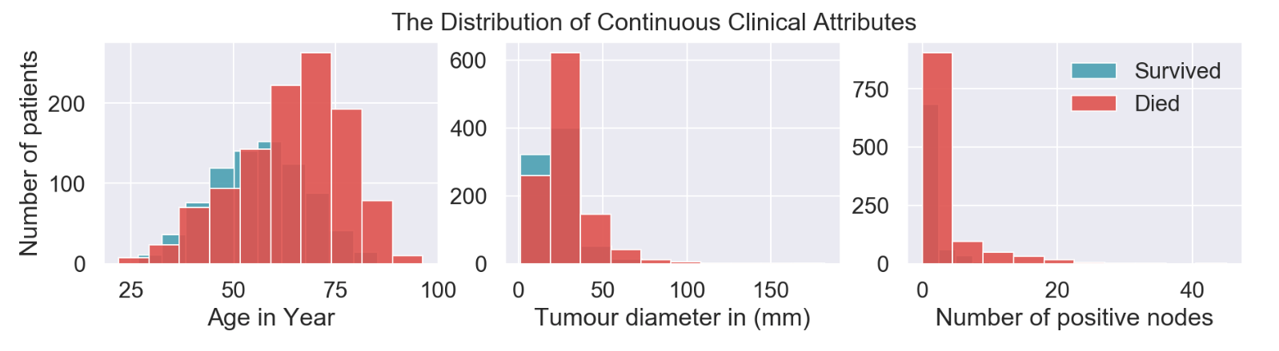
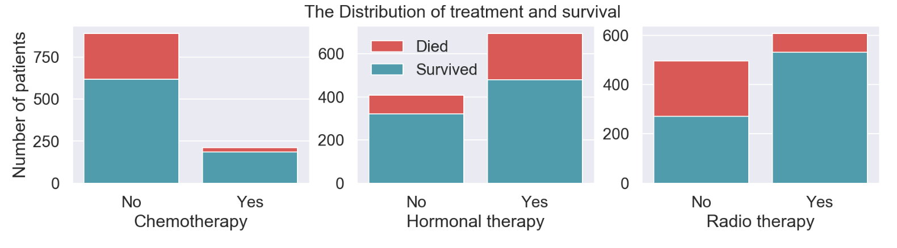
The Distribution of Clinical Features and Survival

Slide 13
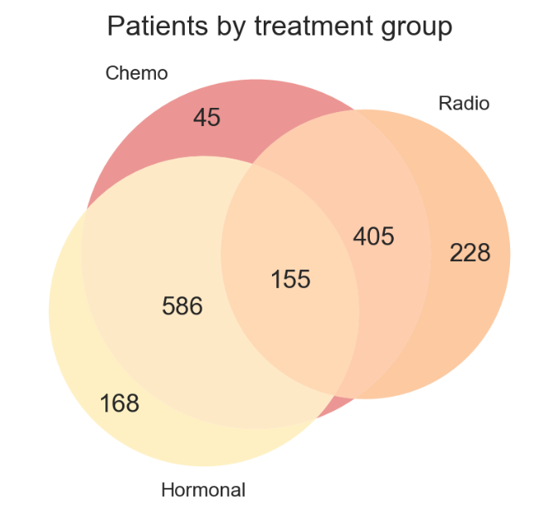
The Distribution of patients by treatment group

Slide 14
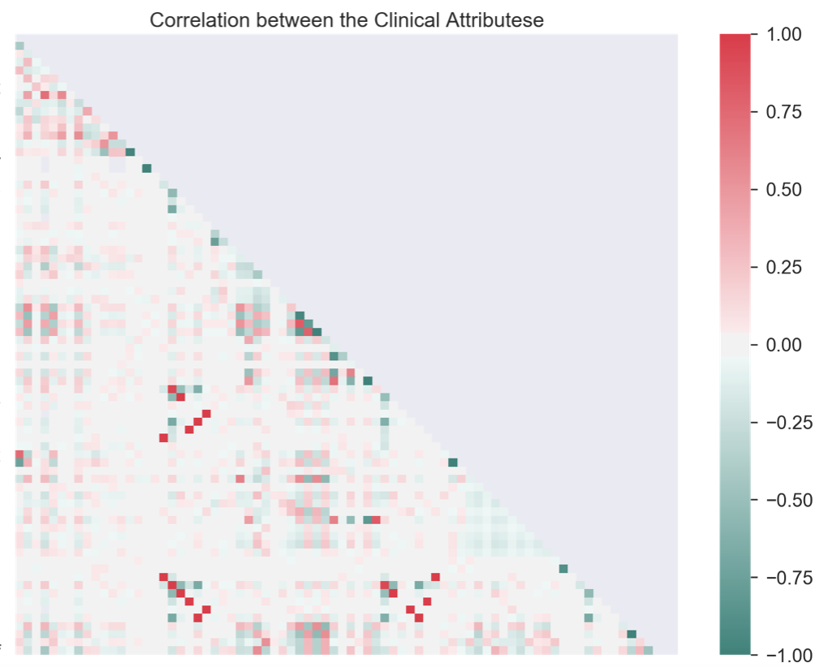
Correlation Between the Clinical Features

Slide 15
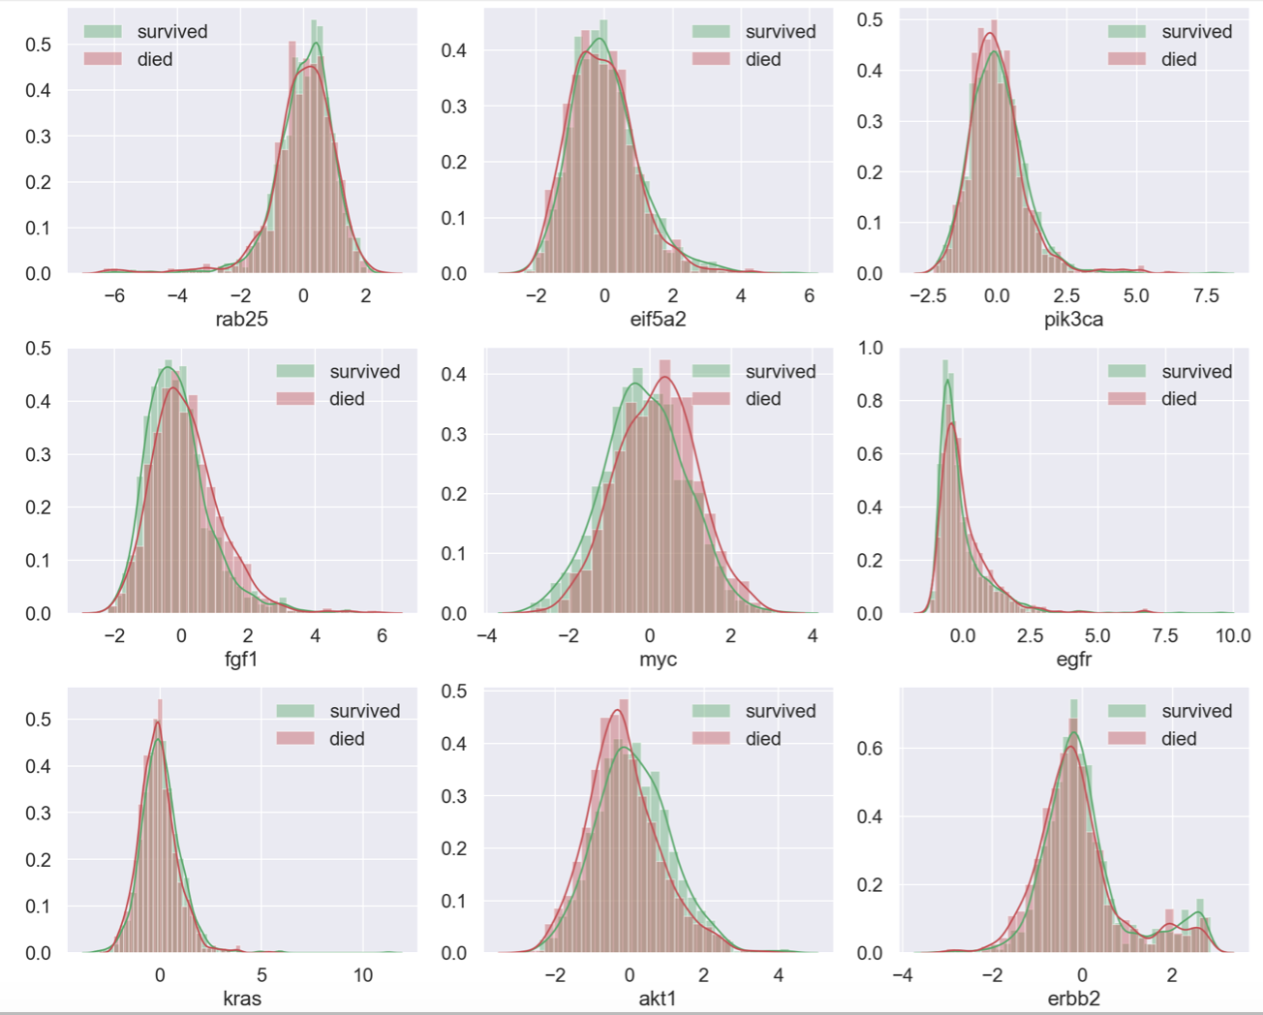
The Distribution of Genetic Features and Survival

Slide 16
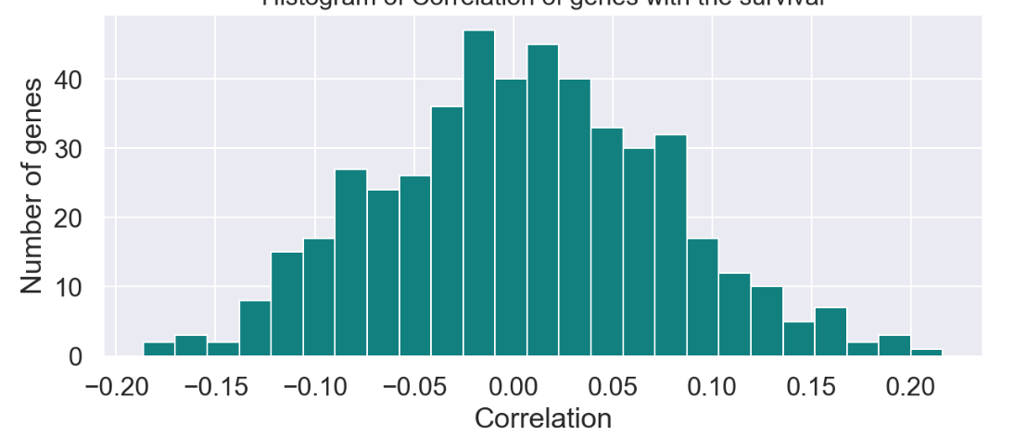
Correlation between Genetic Features and Survival

Slide 17
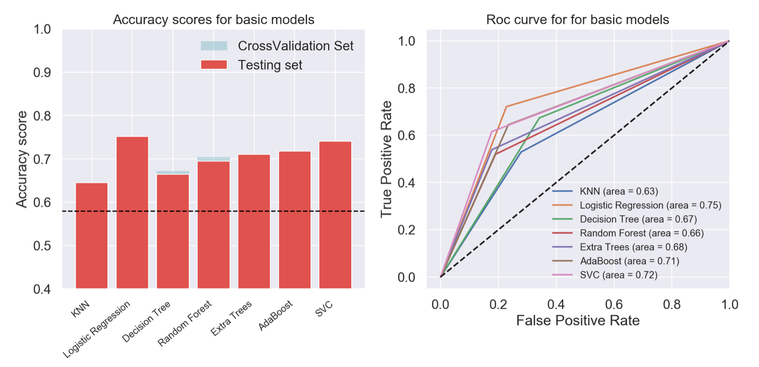
Preprocessing & Modeling
Classification using basic models with all features

Slide 18
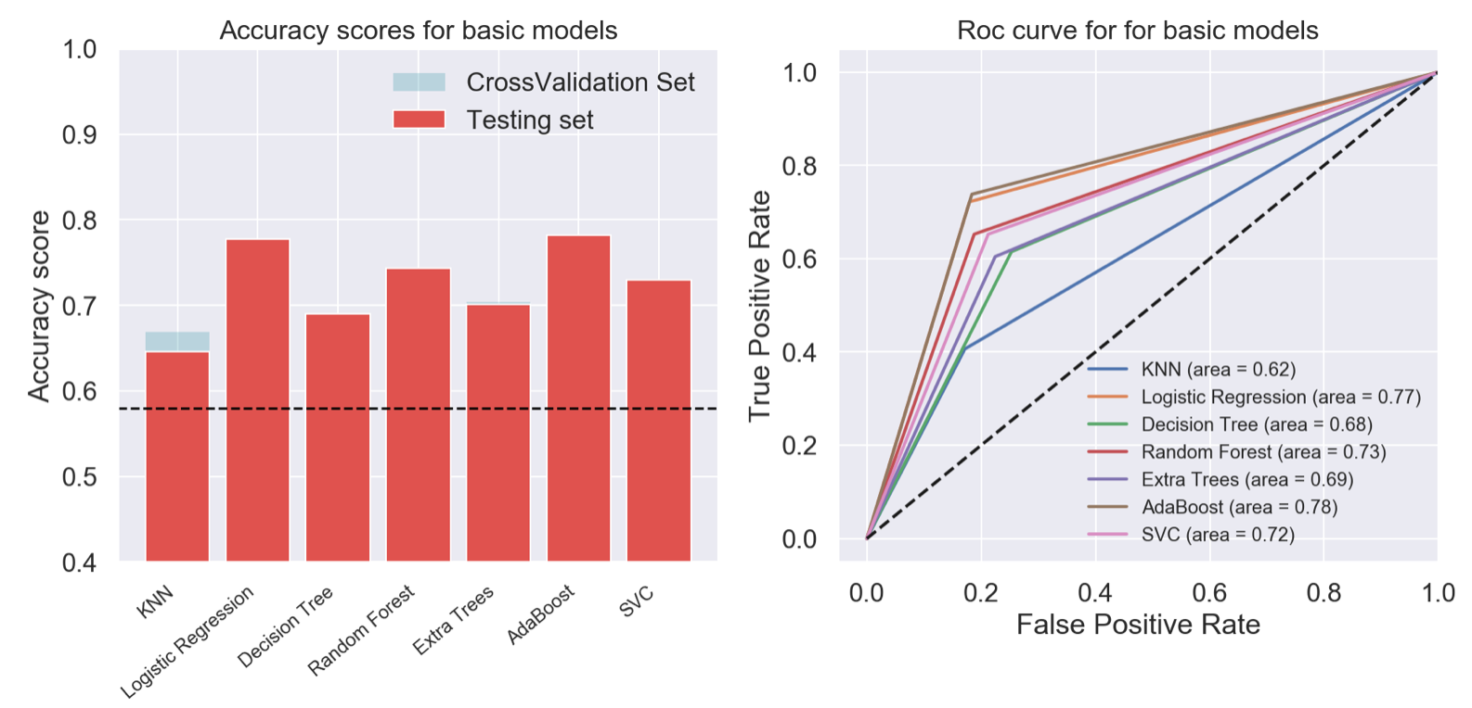
Preprocessing & Modeling
Classification using basic models with only clinical features

Slide 19
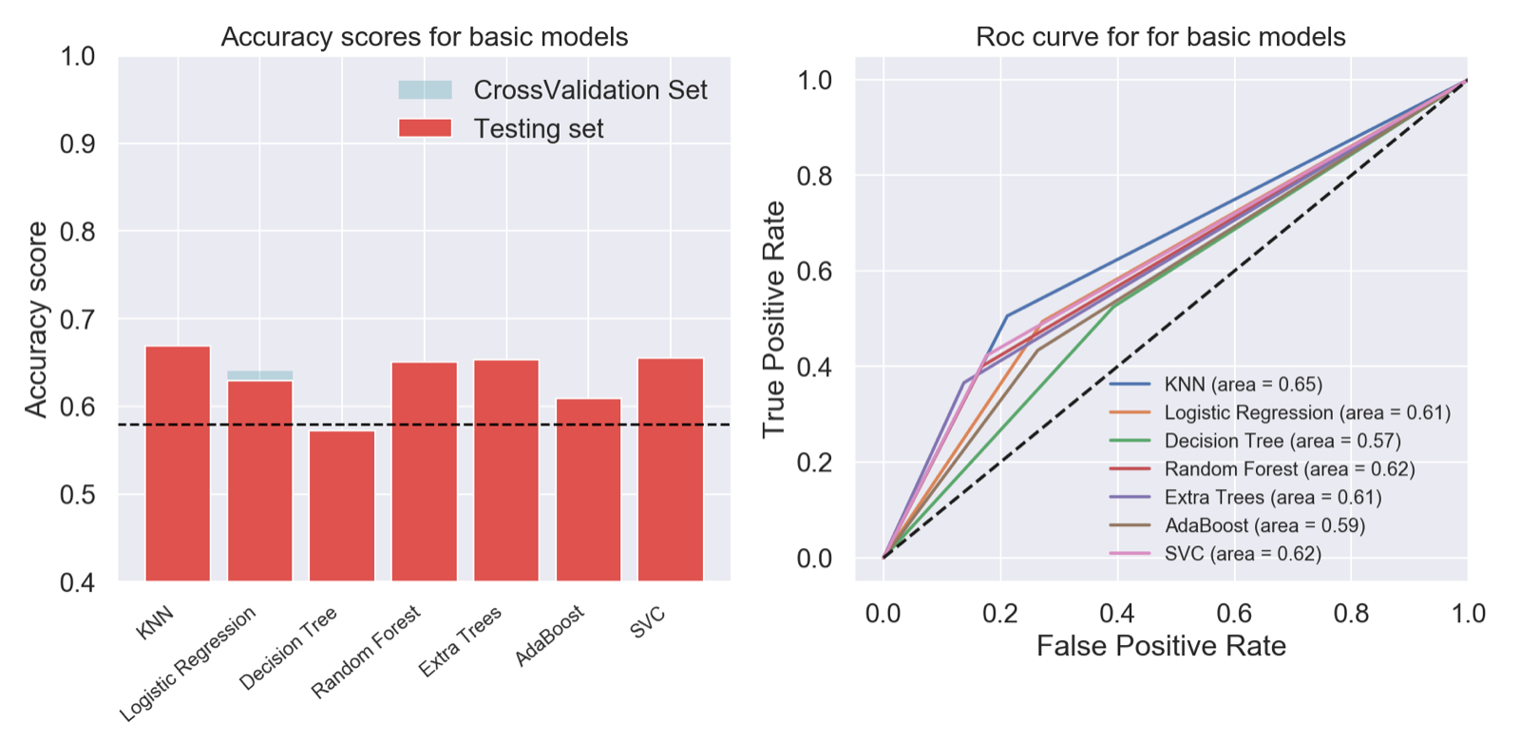
Preprocessing & Modeling
Classification using basic models with only genetic features

Slide 20
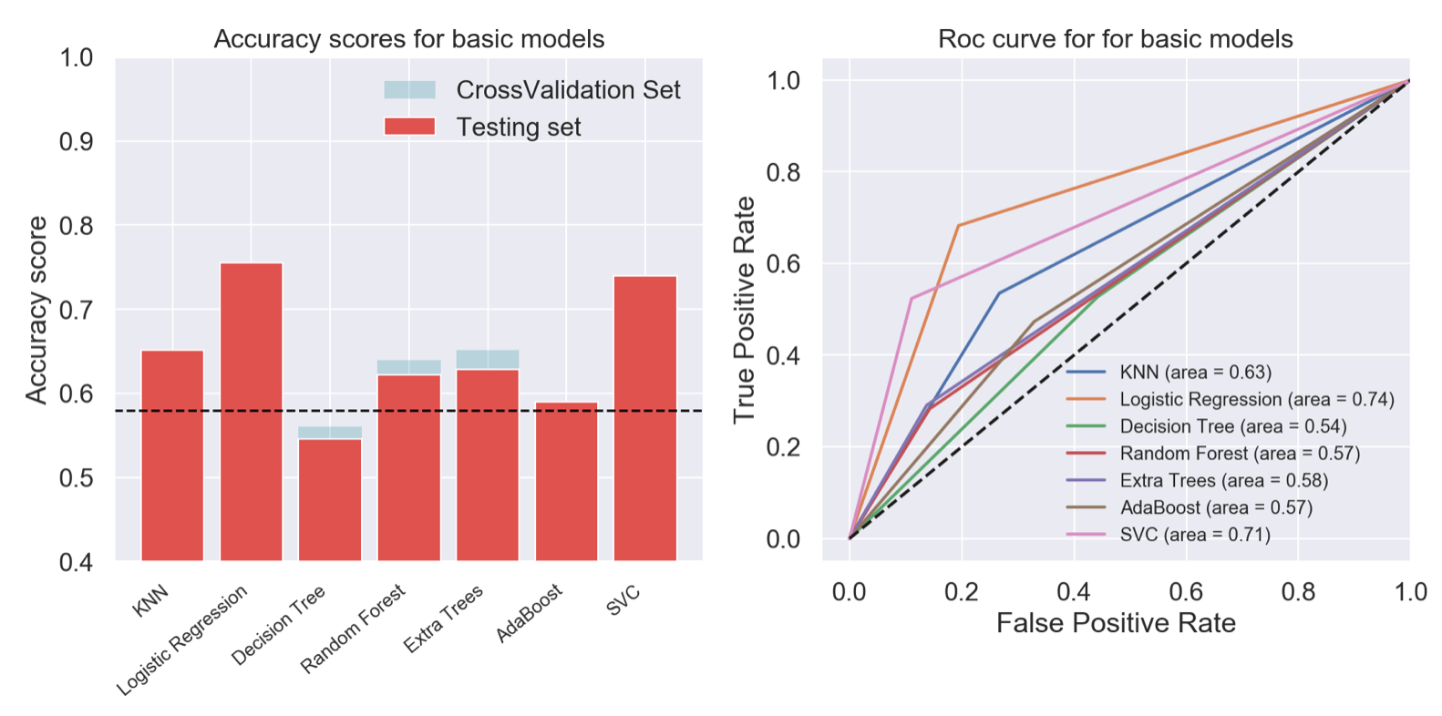
Preprocessing & Modeling
Classification using basic models with only genetic features with combination

Slide 21
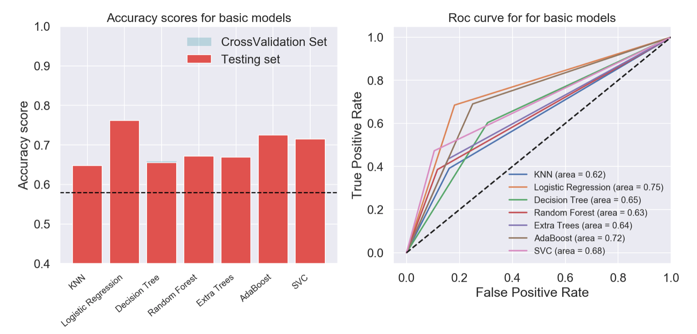
Preprocessing & Modeling
Classification using basic models with all features with combinations

Slide 22
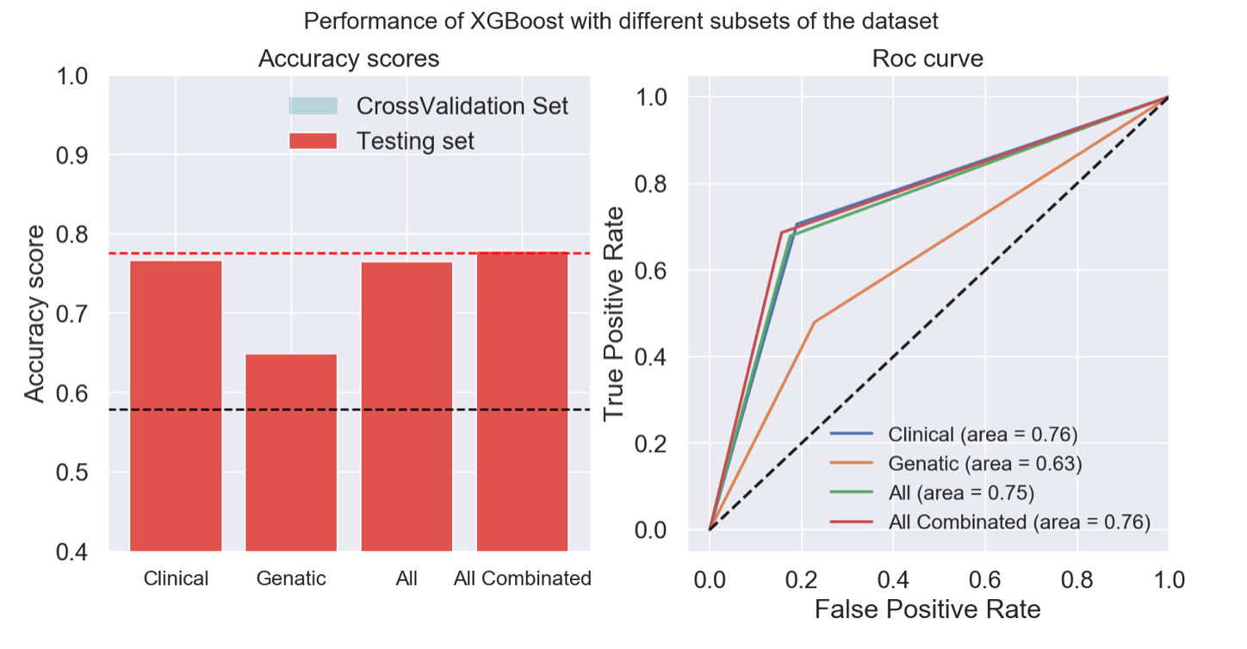
Preprocessing & Modeling
Classification using XGBoost with different subsets of the dataset

Slide 23
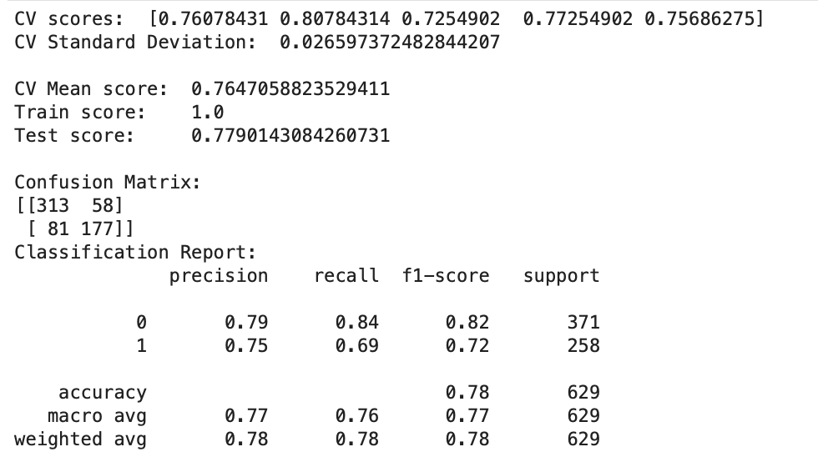
Metrics of the best preforming model XGBoost with grid search for model tuning using the combined dataset

Slide 24
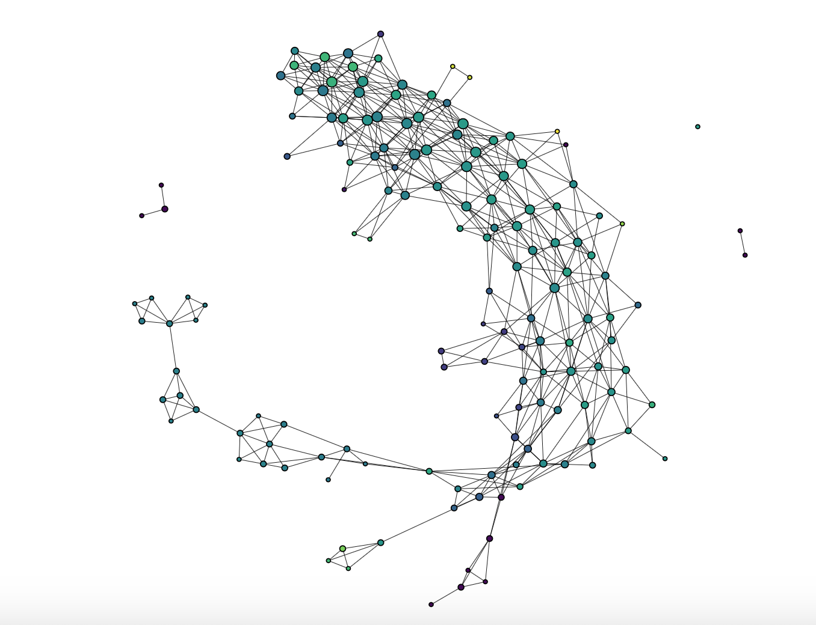
Breast Cancer Gene Clustering Visualization

Slide 25
Conclusion
Using machine learning on genetic data has the potential to improve our understanding of cancers and survival prediction
Huge open-source datasets are available for public to analyze and hopefully get some insights.
To enhance this project, increase the number of samples, include mutations and raw genetic data into the modeling part.

Slide 26
Thank you
Do you have any questions?

Slide 27
References
Pereira, B., Chin, S. F., Rueda, O. M., Vollan, H. K. M., Provenzano, E., Bardwell, H. A., ... & Tsui, D. W. (2016). The somatic mutation profiles of 2,433 breast cancers refine their genomic and transcriptomic landscapes. Nature communications, 7(1), 1-1
Bashiri, A., Ghazisaeedi, M., Safdari, R., Shahmoradi, L., & Ehtesham, H. (2017). Improving the prediction of survival in cancer patients by using machine learning techniques: experience of gene expression data: a narrative review. Iranian journal of publ
Breast Cancer dataset (METABRIC, Nature 2012 & Nat Commun 2016) in CBioPortal
Increasing the resolution on breast cancer – the METABRIC study
Cerami et al. The cBio Cancer Genomics Portal: An Open Platform for Exploring Multidimensional Cancer Genomics Data. Cancer Discovery. May 2012 2; 401.
Gao et al. Integrative analysis of complex cancer genomics and clinical profiles using the cBioPortal. Sci. Signal. 6, pl1 (2013).
World Health Organization - Breast cancer
Van't Veer, L. J., Dai, H., Van De Vijver, M. J., He, Y. D., Hart, A. A., Mao, M., ... & Schreiber, G. J. (2002). Gene expression profiling predicts clinical outcome of breast cancer. nature, 415(6871), 530-536.

